Slide 1
MACHINE LEARNING
25SC2107E
Title of the project:
Heart Disease Prediction Using Ridge- and Lasso-Regularized Logistic Regression
Team Members
Name: B.Devi Charitha
Rollno. 2520030462
Name: P.Hamsika
Rollno. 2520030586
Under the Esteemed Guidance of
Rani Medidha

Slide 2
Contents
Abstract
Introduction
Literature survey
Problem Statement and Objectives
Hardware and Software requirements
Results
Conclusion
Future Scope

Slide 3
Abstract
Heart disease is a major health concern, and early risk prediction can help identify individuals who may require further medical attention. This project develops a machine learning-based application using Logistic Regression with Ridge (L2) and Lasso (L1) regularization to predict heart disease risk based on patient health attributes.
The system performs data preprocessing, feature analysis, model training, and comparison of the three models. Their performance is evaluated using accuracy, precision, recall, F1-score, and ROC-AUC to identify the best-performing model.
The application provides risk probability, risk classification, important feature analysis, model performance visualization, input validation, and prediction history through a simple graphical interface. It is developed using Python, Pandas, NumPy, Scikit-learn, Matplotlib.

Slide 4
Introduction
Background
Heart disease is a significant health problem worldwide.
Machine learning can identify patterns in patient health data.
Logistic Regression is commonly used for binary classification.
Regularization helps control overfitting and improve model generalization.
Proposed Approach
Use patient health attributes to predict heart disease risk.
Compare standard Logistic Regression with Ridge and Lasso regularization.
Develop a simple desktop application for user-friendly prediction.
Main Idea
Train multiple models → Compare performance → Select the best model → Predict heart disease risk.

Slide 5
Problem Statement and Objectives
Problem Statement
Traditional heart disease risk assessment may require considerable time and expert analysis. A machine learning-based application is needed to analyze patient health attributes and provide a quick, consistent estimate of heart disease risk.
Objectives
Develop a heart disease prediction model using Logistic Regression.
Apply Ridge and Lasso regularization to reduce overfitting.
Compare the performance of all three models.
Identify important features influencing predictions.
Develop a simple graphical user interface using Tkinter.
Provide risk probability and prediction results.
Display model performance using graphs and evaluation metrics.
Maintain prediction history for easier review.

Slide 6
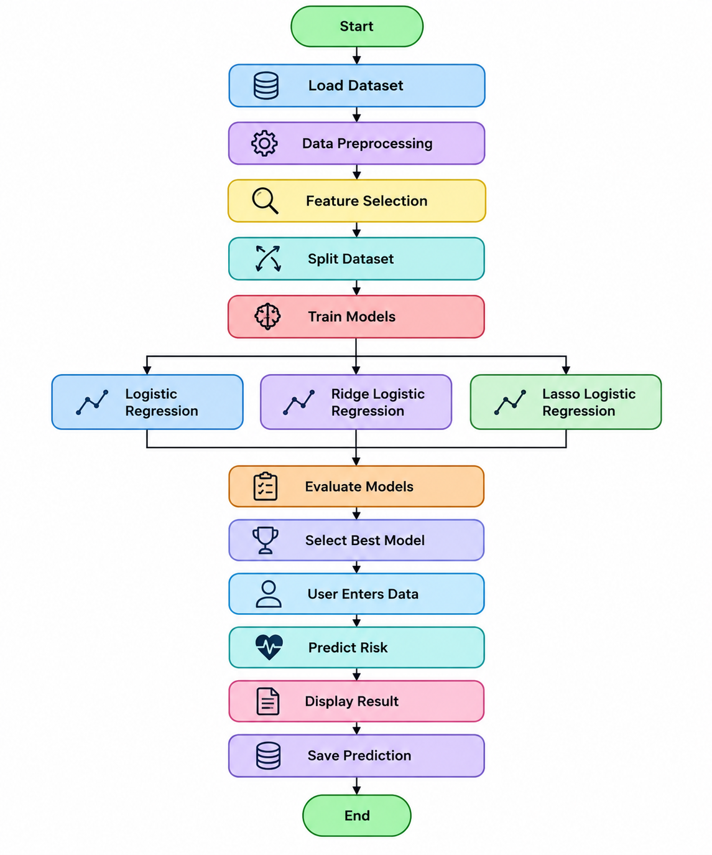
Flow Chart

Slide 7
Results
The system will train and compare Logistic Regression, Ridge Logistic Regression, and Lasso Logistic Regression models.
Model performance will be evaluated using Accuracy, Precision, Recall, F1-score, and ROC-AUC.
A confusion matrix will be used to analyze correct and incorrect predictions.
Ridge and Lasso regularization are expected to reduce overfitting and improve model reliability.
The best-performing model will be selected based on the evaluation results.
The Tkinter-based application will accept patient health details and predict the risk of heart disease.
The application will display the predicted risk category and probability score.
Feature analysis will help identify the health attributes that contribute most to the prediction.
The system is intended for risk prediction and awareness, not medical diagnosis.

Slide 8
Hardware and Software requirements
Hardware Requirements
Processor: Intel Core i3 or equivalent
RAM: Minimum 4 GB
Storage: At least 2 GB of free space
Input Devices: Keyboard and mouse
Display: Standard monitor or laptop screen
Software Requirements
Operating System: Windows, Linux, or macOS
Programming Language: Python 3.x
Libraries: Pandas, NumPy, Scikit-learn, and Matplotlib
GUI Development: React, Vite, FastAPI, GitHub Pages, and Render for creating the desktop application
Dataset: Heart disease dataset in CSV format
Development Environment: VS Code or PyCharm
Model Storage: Joblib for saving and loading trained models

Slide 9
Conclusion
The project develops a machine learning-based heart disease risk prediction application.
Logistic Regression, Ridge Logistic Regression, and Lasso Logistic Regression are used for model development.
Ridge regularization helps control large coefficients and reduce overfitting.
Lasso regularization supports feature selection by reducing some coefficients toward zero.
Model evaluation helps identify the most suitable approach for the dataset.
The Tkinter interface makes the application simple and user-friendly.
Prediction history and feature analysis improve the application's usefulness.
The system provides an educational and decision-support approach to heart disease risk assessment.

Slide 10
Future Scope
Integrate advanced machine learning and deep learning algorithms to improve prediction accuracy.
Use larger and diverse healthcare datasets for better model generalization.
Develop a web-based and mobile application for easy access.
Add real-time health monitoring using wearable devices and IoT sensors.
Improve the user interface with personalized risk reports and visual dashboards.
Enable secure cloud storage for patient data and prediction history.
Perform continuous model updates using newly collected healthcare data.
Integrate the system with healthcare professionals for early risk assessment and awareness.
Include Explainable AI techniques to identify the factors influencing predictions.

Slide 11
Thank you

